Slide 1
Skill acquistion, skill loss, and age (sasla). A comparative study of Cognitive Foundation Skills (CFS) in Denmark, Finland, Norway, and Sweden (# 54861)

Slide 2
project team
Researchers: 11 altogether
3 from Denmark,
2 from Finland,
2 from Norway,
4 from Sweden.
The researchers come from The Danish National Centre for Social Research; Institute for Educational Research and Department of languages, University of Jyväskylä; National Centre for Reading Education and Research, University of Stavanger; Gothenburg University, Institute for Evaluation of Labour Market and Education Policy, Uppsala and Linneaus University.
Scientific board:
professor Antero Malin, Finland (project leader);
associate professor Kjersti Lundetræ, Norway,
associate professor Erik Mellander, Sweden (responsible for dissemination);
senior research fellow Anders Rosdahl, Denmark (responsible for data)

Slide 3
The project in a nutshell
Project period: April 1, 2013 – March 31, 2016
Research focus on separating age and cohort effects on learning and skills over the life cycle
Specific feature: Combines new survey data from PIAAC (Programme for International Assessment of Adult Competencies) with
population register data for the Nordic countries
earlier survey data – IALS (International Adult Lite-racy Survey), ALL (Adult Literacy & Life skills Survey)

Slide 4
Three basic themes
1. The associations between age and CFS in literacy, numeracy and problem solving with ICT. Are there differences between categories of adults, defined by, e.g. educational level, gender, immigrant status, educational and employment/unemployment experiences?
2. How are the associations between age and CFS to be explained? What is the relative importance of cohort effects and age effects, i.e. of when you were born and how old you are? Do the data support the hypothesis that we lose CFS as we age?
3. What are the similarities and differences among the Nordic countries with respect to CFS and age? From PISA we know that Finnish 15-year olds score higher on literacy than youth in other Nordic countries. Do we see the corresponding difference in other age categories, e.g., 25-30 year olds? What factors in youth and adult education may account for differences?

Slide 5
First descriptive report
Article | Title
1 | Introduction
2 | Distributions of skills in the Nordic countries – a comparison
3 | Use of skills at work, Cognitive Foundation Skills, and age
4 | Adult education and training in the Nordic countries
5 | Educational mismatch, skills, and age
6 | Using the PIAAC survey to look at work experience and Cognitive Foundation Skills in the Nordic countries
7 | Comparison of distributions of literacy skills in IALS and PIAAC in Nordic cohorts
8 | Comparison of PIAAC and PISA results
9 | Summary
This report serves as a basis for future work

Slide 6
2. Distributions of skills in the Nordic countries – a comparison
Small variation between countries in L, N and PS
Ranked in order of percentage of adults at levels 3, 4 and 5:
Literacy: FIN, SWE and NOR among top 6 countries, DEN close to OECD average
Numeracy: all countries among top 6 countries
Ranked in order of percentage of adults at levels 2 and 3:
Problem-solving: all countries among top 5 countries

Slide 7
2. Distributions of skills in the Nordic countries – a comparison
Small gender differences in literacy:
FIN: F>M (3 score points)
NOR and SWE: M>F (3 – 4 score points)
Larger gender differences in numeracy: men outperform women in all Nordic countries
NOR 15 score points
SWE 13 score points
DEN and FIN 10 score points
More men than women performing on the highest level in problem solving (FIN 2 % points to NOR 6 % points)

Slide 8
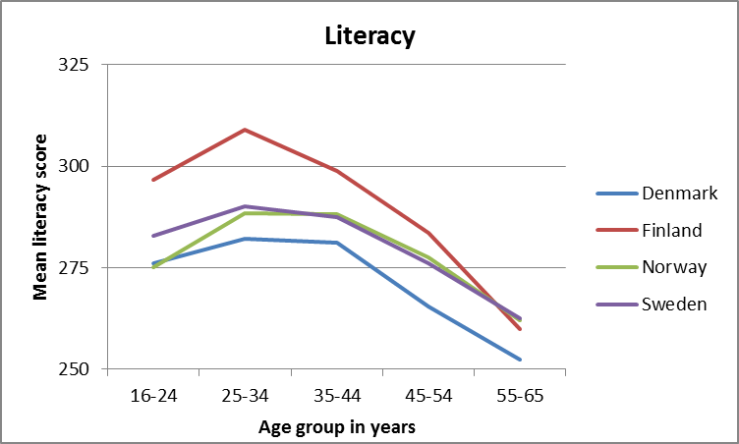
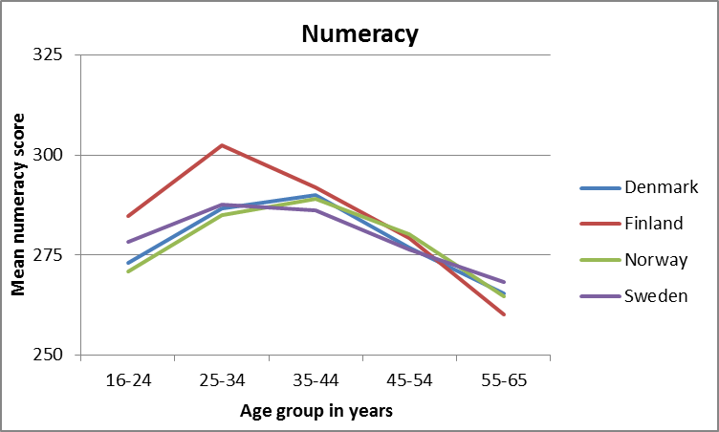
2. Distributions of skills in the Nordic countries – a comparison
Literacy and numeracy by age groups:
25-44 years old have the best skills
55-65 years old perform lower than 16-24 years old
Problem-solving by age groups:
25-34 years old are the best performing group
16-24 years old are the second best performing group
Exception: In Sweden the age groups are in reverse order

Slide 9
2. Distributions of skills in the Nordic countries – a comparison
In all the Nordic countries: large and significant difference in literacy, numeracy and problem solving skills in favor of respondents who were born in the country compared to adults born outside the country.
High educational level is strongly related to a high level of skills.
Adults permanently outside the labour market or unemployed have significantly lower skills in literacy, numeracy and problem solving than those employed or categorized as students.

Slide 10
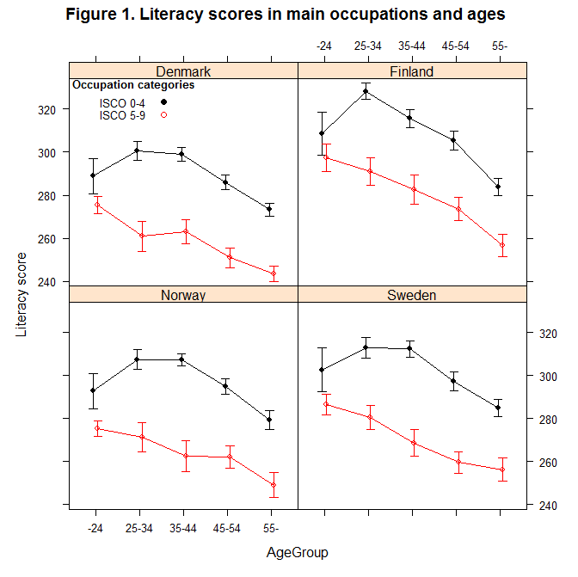
3. Use of skills at work, Cognitive Foundation Skills, and age
The amount of measured CFS declines with age from age category 25-34 or age category 35-44 to age category 55-64.
The decline is present in both the group ISCO 0-4 and in group ISCO 5-9.
The amount of the decline appears to be of about the same magnitude.
The ten major occupational categories are as follows: (0) armed forces occupations, (1) managers, (2) professionals, (3) technicians and associate professionals, (4) clerical support workers, (5) service and sales workers, (6) skilled agricultural, forestry and fishery workers, (7) craft and related trades workers, (8) plant and machine operators and assemblers, and (9) elementary occupations

Slide 11
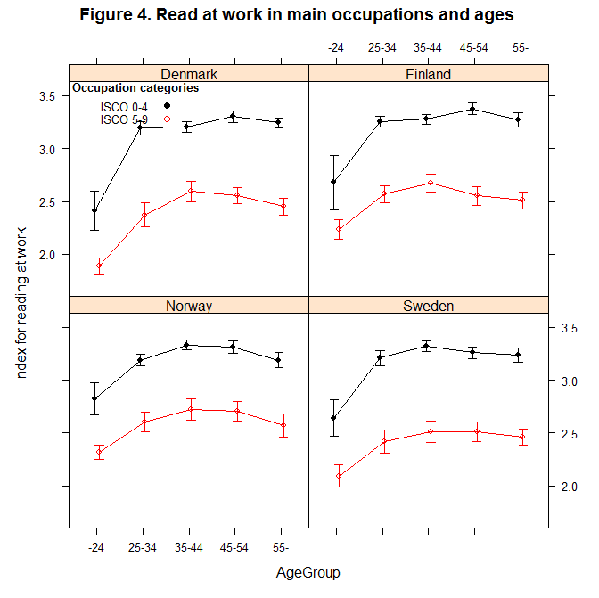
3. Use of skills at work, Cognitive Foundation Skills, and age
The use of CFS at work is approximately constant from age category 25-34 to age category 55-64.
This constancy is present in both the group ISCO 0-4 and in group ISCO 5-9.

Slide 12
3. Use of skills at work, Cognitive Foundation Skills, and age
There are substantial differences between the amount and the use of CFS between group “ISCO 0-4” and group “ISCO 5-9”.
From age category 25-34 both the amount and the use of CFS is substantially higher in group “ISCO 0-4” than in group “ISCO 5-9”.
Workers with high levels of CFS in the Nordic countries thus appear to sort into occupations with relative intensive use of these skills.
The results of the paper does not support the ‘use it or lose it’ hypothesis, that a lack of use of human capital entails a depreciation of the amount of human capital (or productive skills).

Slide 13
4. Adult education and training in the Nordic countries
Percentage of adults participating in formal and/or non-formal adult education and training (AET) by country during one year preceding the survey.
 | DEN | FIN | NOR | SWE | AVERAGE
Formal or non-formal AET:
Overall participation rate | 66,8 | 66,0 | 64,8 | 65,4 | 65,8
Reason for participation:
Job-related | 77,9 | 72,7 | 76,3 | 72,0 | 74,7
Non-job-related | 11,9 | 16,0 | 11,7 | 19,6 | 14,8
Unknown | 10,1 | 11,3 | 12,1 | 8,3 | 10,4
Formal AET:
Overall participation rate | 17,9 | 16,5 | 18,0 | 14,2 | 16,7
Reason for participation:
Job-related | 80,2 | 79,0 | 72,6 | 70,0 | 75,5
Non-job-related | 9,0 | 19,2 | 15,5 | 28,1 | 18,0
Unknown | 10,8 | 1,8 | 11,8 | 1,9 | 6,6
Non-formal AET:
Overall participation rate | 59,9 | 60,4 | 58,8 | 60,2 | 59,8
Reason for participation:
Job-related | 76,2 | 70,3 | 76,7 | 72,3 | 73,9
Non-job-related | 13,7 | 16,0 | 11,2 | 17,8 | 14,7
Unknown | 10,0 | 13,7 | 12,1 | 9,9 | 11,4

Slide 14
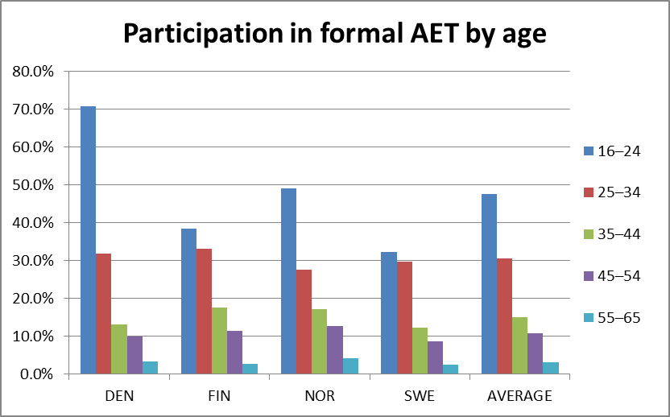
4. Adult education and training in the Nordic countries
Figure 1. Percentage of adults participating in formal adult education by country and by age.

Slide 15
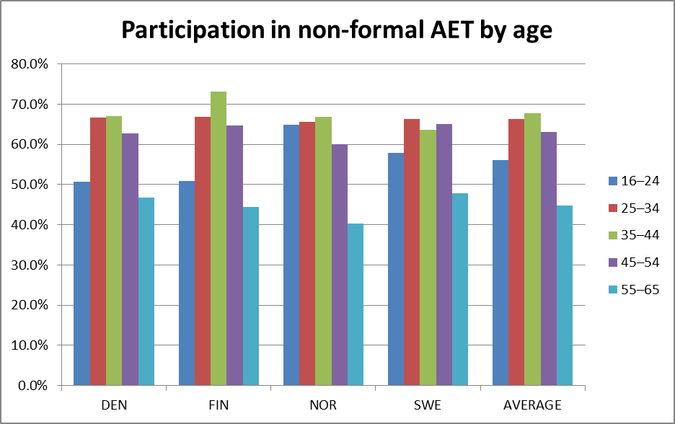
4. Adult education and training in the Nordic countries
Figure 2. Percentage of adults participating in non-formal adult education by country and by age.

Slide 16
4. Adult education and training in the Nordic countries
Females were slightly more active than men:
Overall participation rate for men was 63-65 % and for women 66-69 %
Higher educational level => higher participation rate in AET
Less than upper secondary degree => 38 – 52 %
Higher than upper secondary degree => 78 – 81 %

Slide 17
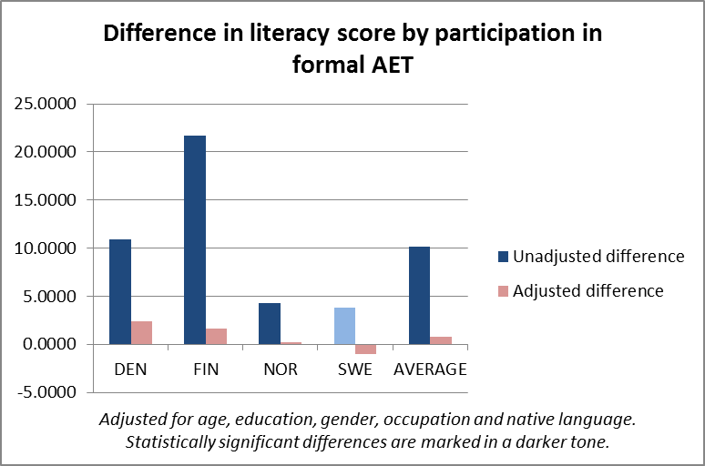
4. Adult education and training in the Nordic countries
Figure 8a. Unadjusted and adjusted score point differences in literacy by participation in formal adult education and by country.
Unadjusted differences: Yes
Adjusted differences: No
Differences are similar in numeracy and problem- solving

Slide 18
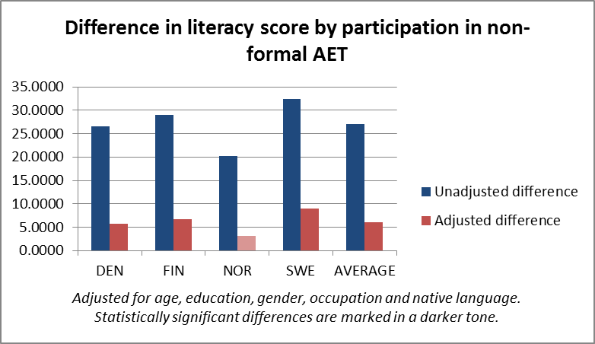
4. Adult education and training in the Nordic countries
Figure 9a. Unadjusted and adjusted score point differences in literacy by participation in non-formal adult education and by country.
Unadjusted differences: quite large
Adjusted differences: quite small
Differences are similar in numeracy and problem- solving

Slide 19
5. Educational mismatch, skills, and age
Different measures of educational mismatch:
Direct self-assessment (hiring SA): Respondents have been asked, what level of education would be needed to get their job today.
Self assessment (doing SA): Respondents have been asked, what level of education would be needed to do their job well.
Job-analysis approach (JA): Uses available job classification systems where for each category of jobs there is an associated educational level that is deemed needed for a given job.

Slide 20
5. Educational mismatch, skills, and age
The different measures of educational mismatch give substantially different incidences of over- and under-education.
Using the objective Job Analysis (JA) measure, where respondents’ educational level is compared to the ISCO08 skill level of their job gives lower incidence of over-education than the Self-assessment measures (SA) for all Nordic countries.
The difference in incidence of under-education between Job Analysis (JA) and Self-assessment measures (SA) is different for different countries
JA gives lower incidence of under-education than SA in Finland and Sweden
JA gives higher incidence of under-education than SA in Denmark and Norway

Slide 21
5. Educational mismatch, skills, and age
Looking at the entire population, controlling for age, gender, and educational level, we see that:
For all three measures (two self-assessment and the JA) and for numeracy and literacy, under-educated performs better, on average, than their peers with a well-matched job.
Clarification: the under-educated have jobs on a higher skill level than the well-matched that they are compared against, but with the same educational level
The same for over-educated: they perform, on average, worse than their peers with well-matched jobs.
However, the estimates are only significant for all countries and mismatch-groups when using the SA (hiring) – i.e. comparing the level of education with the level needed to get the job – or the JA measure.
For SA (doing) – the level of education vs. the level needed to do the job – the results are not significant.
An exception to c. is Finland using SA (hiring) where over-educated do not perform significantly worse than well-matched
For problem-solving more countries and mismatch-groups show insignificant (or significant only at the 10-percent level) estimates. So the results are more clear for literacy and numeracy.

Slide 22
5. Educational mismatch, skills, and age
Age and educational mismatch
According to all three measures, there is a tendency that:
The incidence of over-education is higher among the younger and lower among the older.
The incidence of under-education higher among the older.

Slide 23
6. Using the PIAAC survey to look at work experience and Cognitive Foundation Skills in the Nordic countries
Number of children and work experience:
For all four of the Nordic countries, the number of children has fundamentally different impacts on the work experiences of men and women
For a couple, an extra child results in a female-male difference in work experience between -1.2 year (in Denmark) and -1.9 years (in Norway)
Men: An extra child results in 0.70 – 0.85 years of extra work experience
Women: An additional child reduces the number of years of work experience with 0.5 – 1.0 years

Slide 24
6. Using the PIAAC survey to look at work experience and Cognitive Foundation Skills in the Nordic countries
Skills and work experience (controlling for the respondent’s age, level of education, industry and sector of employment, occupation, participation in on-the-job training and the levels of parents’ education)
For literacy skills, there is essentially no influence from work experience at all.
For numeracy skills, a highly significant relation is found; an extra year of experience corresponds to 3.0 – 3.7 score points, across the Nordic countries.
For problem solving skills in TRE, a positive relation is found in Denmark, Norway and Finland. The magnitude is only about half of that for numeracy, however.

Slide 25
7. Comparison of distributions of literacy skills in IALS and PIAAC in Nordic cohorts
This comparison can be made only for literacy proficiency
Comparing the percentages of correct responses at item level
Unfinished, some work still needed

Slide 26
8. Comparison of PIAAC and PISA results
Comparing the cognitive performance of 15-years-olds with the cognitive performance of the youngest cohorts (16-25 years) in PIAAC.
Is the same cross-country variation reflected in the youngest PIAAC cohorts.
How well PISA results are associated with CFS needed in adult life?
Unfinished, some work still needed

Slide 27
Next steps
4 research papers for scientific journals, 1 from each participating country
End of 2014
4 research papers for scientific journals, 1 from each participating country
Middle of 2015
Report summarizing the results in non-technical terms, beginning of 2016
Dissemination of the results: press releases, Nordic conferences (researchers, policy makers, practitioners), international and national scientific conferences

Slide 28
Thank you very much!
antero.malin@jyu.fi

